Slide 1
Factor Investing In A-shr Market
Smart beta and beyond

Slide 2
Factor Investing and Smart Beta
What’s a factor?
Any variable or combination of variables that is believed to be consistent in predicting investment future returns and/or risk profiles. Classical examples such as value, size etc.
A factor investing strategies focus on the construction of a portfolio with an optimal allocations towards those factors.
What’s the difference of alpha seeking and smart beta strategies?
Risk factors tend to be good at explaining cross sectional stock risk profiles, typically with a significant factor return volatility but a modest average excess return.
Alpha factors are harder to get by: a significant unconditional mean with less volatility to produce consistent performance. Moreover, alpha factors can be ephemeral due to arbitrage, change of market regimes and regulatory overhaul. To address the challenges imposed by time varying alphas, factor timing is needed to maintain the portfolio performance.
As the result of the observed alpha decaying phenomenon, smart beta (or risk premium) strategies have become more popular these days for its transparency and cost-efficiency.
Why do we need a factor investment strategy?
To overcome the possibility of “sin of story telling”. Factor

Slide 3
Common factors
Factors | Definition | Characteristics
value | Captures excess returns to stocks that have low prices relative to their fundamental value | Book to price,earnings to price, book value, sales, earnings, cash earnings, net profit, dividends, cash flow
low size | Captures excess returns of smaller firms (by market capitalization), relative to their larger counterparts | Market capitalization (full or free float)
momentum | Reflects excess returns to stocks with stronger past performance | Relative returns (3mth, 6mth, 12mth, sometimes with last 1 mth excluded), historical alpha
low volatility | Captures excess returns to stocks with lower than average volatility, beta, and/or idiosyncratic risk | Standard deviation (1yr, 2yrs, 3yrs), Downside standard deviation, standard deviation of idiosyncratic returns, Beta
dividend yield | Captures excess returns to stocks that have higher than average dividend yields | Dividend yield
quality | Captures exc ess returns to stocks that are characterized by low debt, stable earnings growth, and other “quality” metrics | ROE, earnings stability, dividend growth stability, strength of balance sheet, financial leverage, accounting policies, strength of management, accruals, cash flows

Slide 4
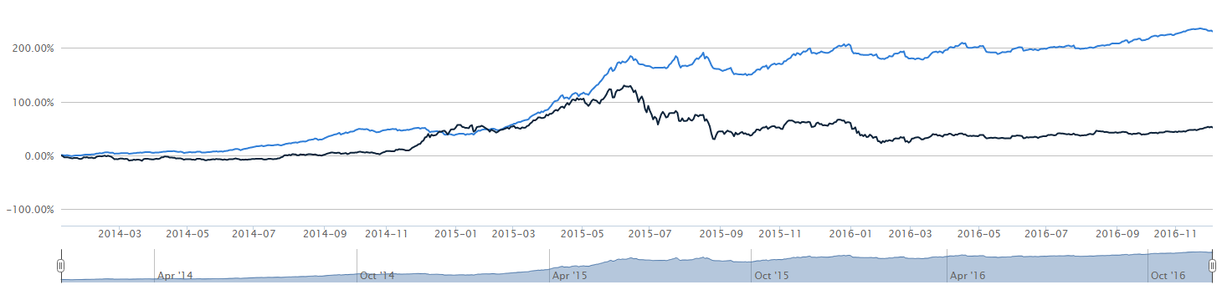
Factor Performance Illustration
Overview
We analyzed the performance of the non-volatility controlled baseline strategy for enhanced size factor below from 2014 till YTD (Stock universe: China A-shr stocks excluding IPO’s) . The excessive return was outstanding at 52%, as compared to the 16% annualized return of the benchmark index (CSI-300) during the same period.
Exhibit A displays the strategy performance and asset allocation during the market turmoil. Note that the factor return suffered sizable drawdowns in mid 2015 (market crash due to elevated bubble) and early 2016 (circuit breaker rule led to dissipated market liquidity)
The drawdowns can be further mitigated via position control and diversified with other factors w/o significantly impeding the performance
Exhibit A: Accumulated returns of size factor vs. benchmark

Slide 5
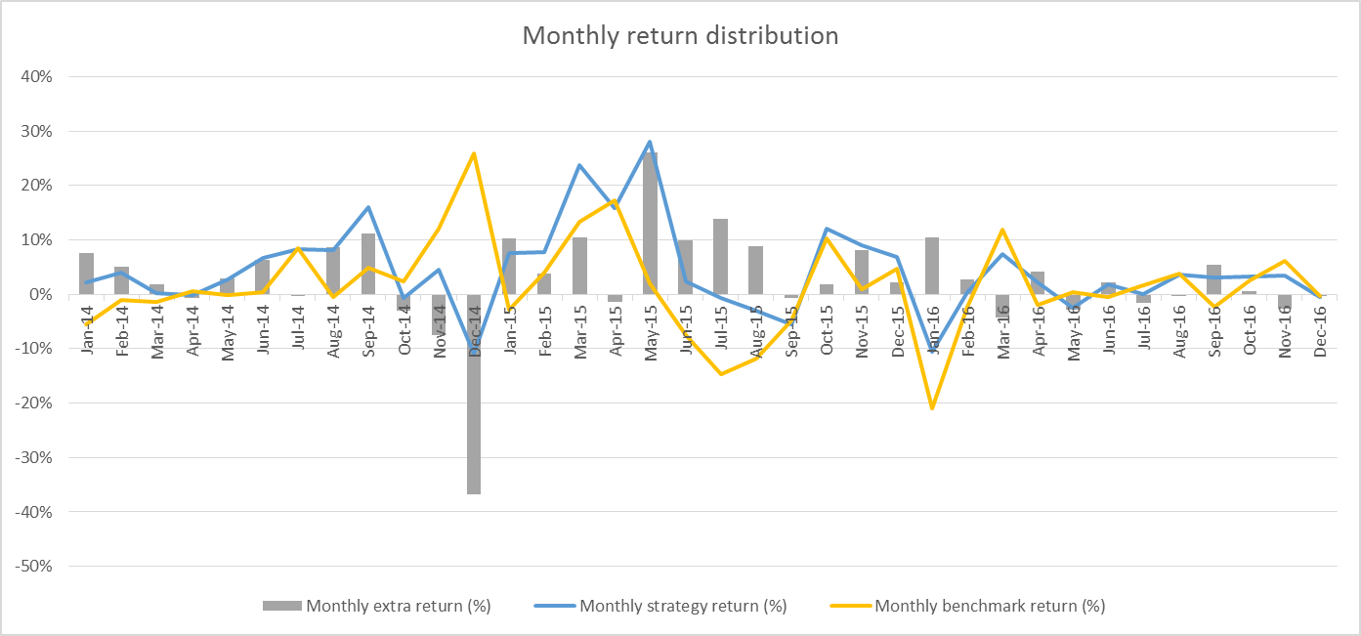
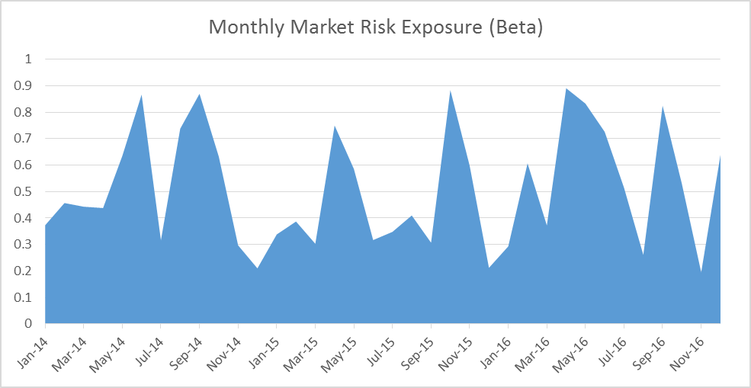
Factor Performance Illustration -- monthly breakdowns
Risk Profiles
Exhibit A displays the strategy monthly performance during the period, relative to the corresponding benchmark returns. About 2/3 of all months the factor records positive returns with an average of 7.13% and 1/3 of all months the factor records negative returns averaged to -4.8%
Exhibit B shows the rolling market exposures for the strategy which averages to 0.29 over the two year intervals. Most of the high beta exposures happen when the market returns are positive and the beta exposure contributes to the overall performance. The biggest laggards happened in Dec 2014 when the market was overtaken by a sudden rotation of the big-cap names and the majority of the market suffered for lackluster performance and only reverted in later months. We may also neutralize the beta exposures with CSI-300 index futures as needed
Exhibit A: Monthly return distribution
Exhibit B: Monthly beta exposure

Slide 6
Predictive Power
How do we assess the predictive power of each factor?
Rank by

Slide 7
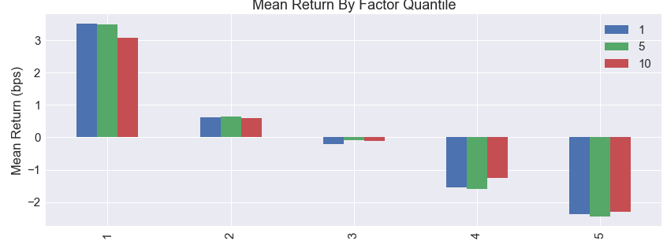
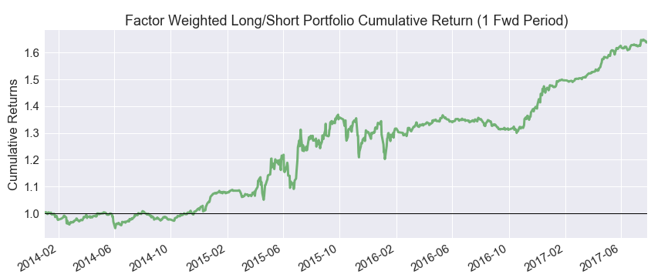
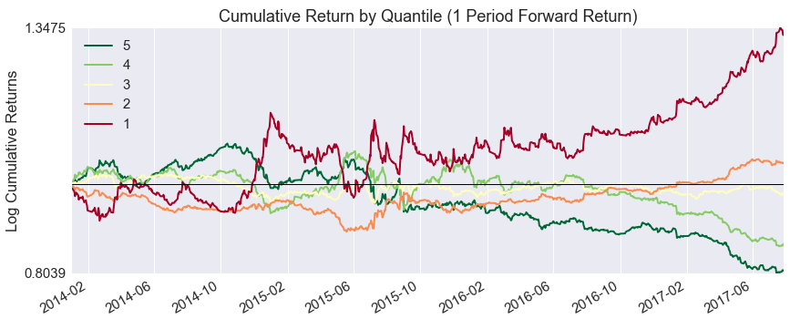
Value (P/E Ratio)

Slide 8
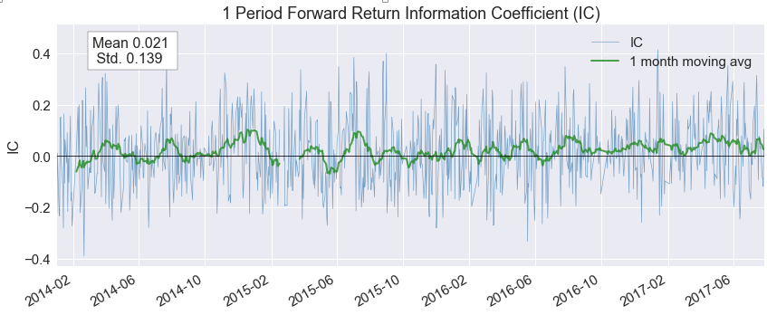
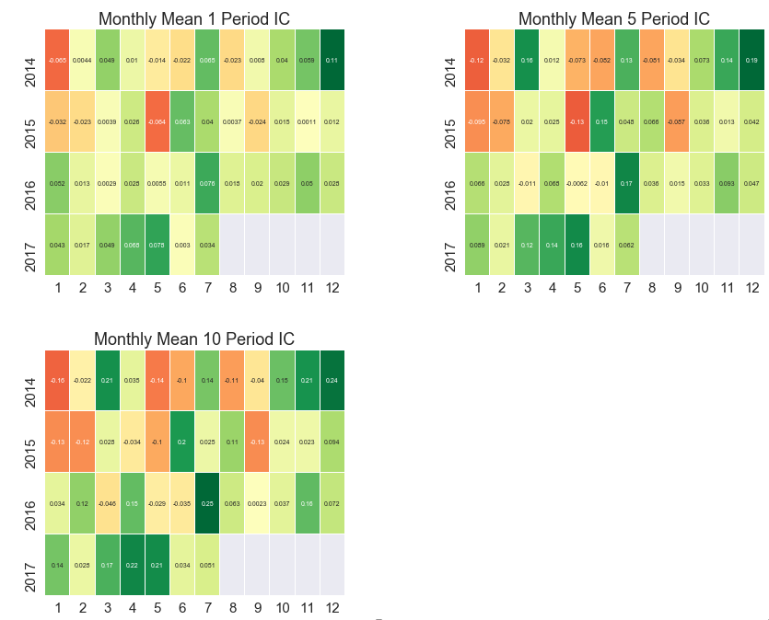
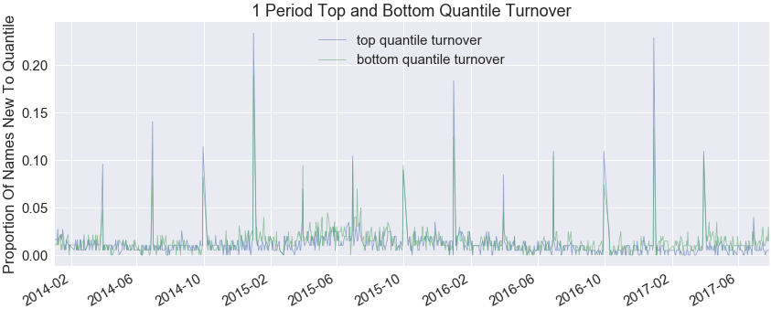
Value (PE Ratio)
Factor Quantile | min | max | mean | std
1 | 0.43 | 36.83 | 13.18 | 5.34
2 | 13.47 | 61.87 | 26.84 | 6.79
3 | 23.17 | 108.42 | 43.70 | 11.56
4 | 36.89 | 214.97 | 74.92 | 24.57
5 | 63.61 | 5288752.00 | 4856.39 | 130241.75

Slide 9
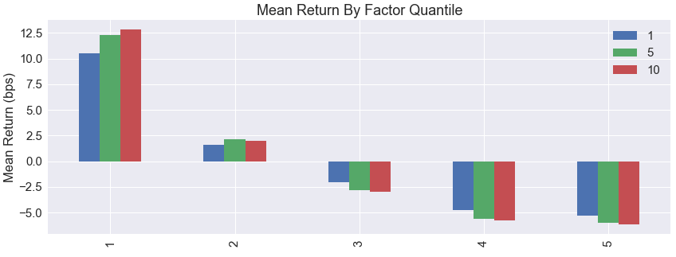
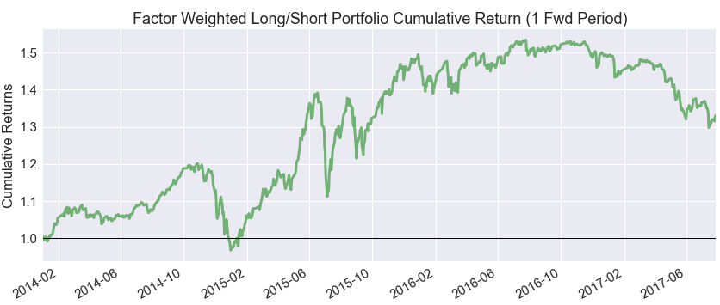
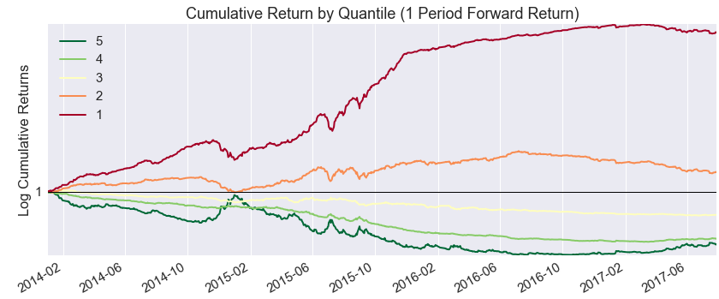
Size (Market Cap)
Factor | Annul. Alpha (%) | Beta (%)
Value | 19.8% | -1.0%
Size | 1.2% | 27.0%
Dividend
Momentum
Volatility | 1.3% | 16.4%
Turnover | 15.6% | 4.2%
Quality

